Slide 1
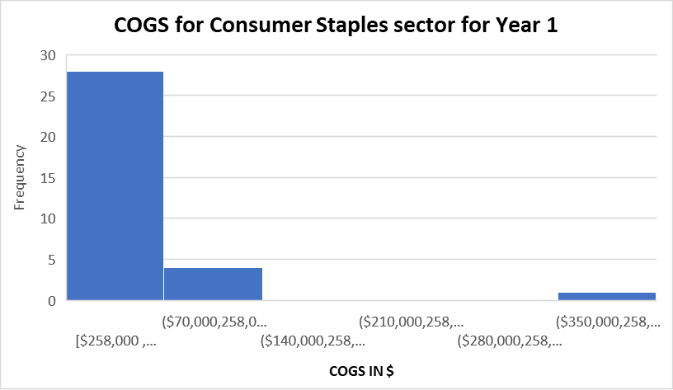
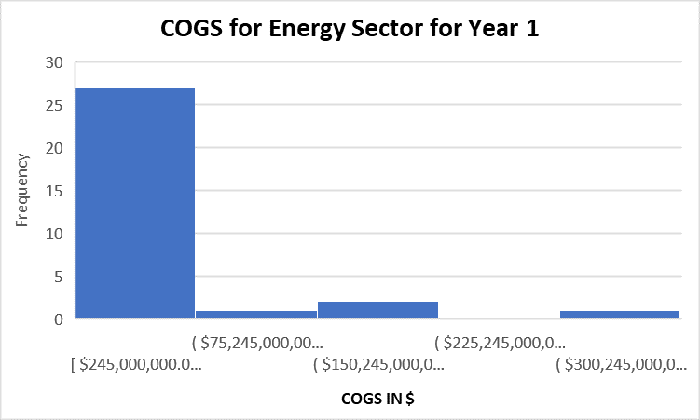
How do COGS for Consumer Staples and Energy Sectors differ in Year 1?
Here are the Histograms for COGS for the sectors of Consumer Staples and Energy in Year 1.
Both of them are right-skewed or positively skewed. This means that mean is higher than median in both cases.
Means of both sectors are pretty much similar with $31 billion for Consumer Staples and $30,9 billion for Energy sector. However, median of Consumer Staples ($8 billion) is more than double that of energy sector ($3 billion). The standard deviation for energy sector ($67 billion) is a bit more than Consumer Staples ($64 billion). This means, companies in energy sector spend more variety of amounts than that of consumer staples. Range in Consumer Staples is $352 billion, while that of Energy sector is $301 billion. That means, Companies of consumer staples spend more amount of money than that of energy sector (comparing $350 and $300 in the Histograms).
.

